Slide 1
Unit 2: Week 1
Grade K

Slide 2
Copyright © Savvas Learning Company LLC. All Rights Reserved.
This publication is protected by copyright, and permission should be obtained from the publisher prior to any prohibited reproduction, storage in a retrieval system, or transmission in any form or by any means, electronic, mechanical, photocopying, recording, or otherwise. For information regarding permissions, request forms, and the appropriate contacts within the Savvas Learning Company Rights Management group, please send your query to:
Savvas Learning Company LLC, 15 East Midland Avenue, Paramus, NJ 07652
or
k12learningpermissions@savvas.com
myView Literacy® is an exclusive trademark of Savvas Learning Company LLC in the U.S. and/or other countries.

Slide 3
Page
Introduce the Unit
Essential Question:
What do living things need?
What did you hear in the video?
What did you see in the video?
Notes:
Introduce the Essential Question for Unit 2: What do living things need? Tell students they will read many texts to learn about the different things that plants and animals need. Explain that reading texts in a variety of genres is important; each author gives different information and writes about the theme in a different way.
Watch the Unit Video Tell students that a multimedia text can use both sound and pictures. A video is a multimedia text. Have students pay attention to the sound and pictures as they watch “Buzz, Buzz, Buzz!” Click Path: Table of Contents -> Unit 2: Living Together -> Unit 2: Introduction
Tell partners to discuss what they learned about living things by watching the video. Use the following questions to guide their discussions.
What did you hear in the video?
What did you see in the video?

Slide 4
Page 12
Unit Goals
Turn to page 12 in your
Student Interactive.
Circle living things.
Notes:
Read aloud the bulleted list of goals on pg. 10 in the Student Interactive.
Have students color the ”Thumbs Up” if they feel they have already accomplished the goal, or the “thumbs down” if they think they have more the learn. Students will revisit this page in Week 6.

Slide 5
Page 13
Academic Vocabulary
Expand: To grow is to get bigger or change.
Ask: Name an animal. How does it grow?
Expand: People need water and food to live.
Ask: What do plants need to live?
Expand: When we share objects, everyone takes turns using things.
Ask: What can you share in the classroom?
Expand: People depend on plants for food.
Ask: How do plants depend on people?
Notes:
Academic Vocabulary is language used to talk about ideas. Explain that as students work through the unit, they will learn and use these academic words to discuss living things. Tell students to turn to p. 13 in the Student Interactive. Read the words and sentences aloud. Then use the EXPAND and ASK questions below for each word. Have students respond using the newly acquired Academic Vocabulary as appropriate.
Call attention to the picture on p. 13. Tell students to talk about the picture with a partner, using the Academic Vocabulary words.

Slide 6
Lesson 1

Slide 7
Page 16
Phonological Awareness
Turn to page 16 in your Student Interactive.
Notes:
Tell students that today they will learn a new sound. Listen carefully as I say the new sound: /d/ /d/ /d/. The sound /d/ is made by placing your tongue behind your top teeth, then pushing air through, making the sound /d/. Show students how to make the sound /d/ and have them practice it. Try saying the sound /d/ several times.
Have students turn to p. 16 in the Student Interactive. Point to the picture of the dog. Listen to the sounds as I say this word: /d/ /o/ /g/. The first, or initial, sound in the word dog is /d/. Name each picture in the first row on p. 16 and have students circle the picture words with the initial sound /d/ like dog. Repeat this process for picture words that end with the sound /d/ in the second row.

Slide 8
Phonics
dog
bed
dinosaur
mad
pad
dime
dance
lid
Dd
Notes:
Hold up the Alphabet Card for Dd and point to the picture of the dolphin. Have students say dolphin with you. Let’s say the sound at the beginning of the word: /d/ -olphin. The beginning sound /d/ is spelled with the letter d. Point to the letters Dd on the Alphabet Card. Tell students the word dolphin begins with the sound /d/, so it begins with the letter d. Click path -> Table of Contents -> Unit 2 Week 1 Informational Text -> Lesson 1
Write the letters Dd on the board. Have students turn to p. 17 in the Student Interactive and trace the letters on the first line. Tell students that you will say a group of words that will either have the beginning or ending sound /d/. Have students listen for the sound /d/ and trace the letter in the air as you say each word that includes the sound /d/. Use the following words, emphasizing the sound /d/: dog, bed, dinosaur, mad, pad, dime, dance, lid.

Slide 9
Page 17
Phonics
Turn to page 17 in your Student Interactive and complete the activity.
Notes:
Have students look at p. 17 in the Student Interactive. Point to the letter d and tell me the sound it spells. Now we will circle each picture name that begins or ends with /d/. Say the picture name dot, emphasizing the initial sound: /d/ /d/ /d/ /o/ /t/. Does the word for this picture begin with the sound /d/? Yes, it does, so we will circle it. Instruct students to complete the activity.

Slide 10
High-Frequency Words
are
that
of
Notes:
Display the high-frequency words are, that, and of.
Point to the word are and read it.
Have students point to the word are and read it.
Repeat for that and of.

Slide 11
Page 52, 53
Interact with Sources
Essential Question: What do living things need?
Weekly Question: Why do some animals move from place to place?
Notes:
Have students turn to p. 14 of the Student Interactive. Remind students of the Essential Question for Unit 2: What do living things need? Point out the Week 1 Question: Why do some animals move from place to place? Explain that this week students will learn why some animals move from place to place. Read aloud the heading.
Read aloud the text on p. 14 and have students follow along. Explain to them that animals sometimes move from place to place and that the whooping crane is one such animal. Then read the infographic “Time to Move!” Point out to students that during the winter it gets cold in the north, but it is warm in the south.
Use the following prompts to guide discussion:
Ask students to predict where they think the whooping crane goes when it gets cold.
Point to the map on p. 15. Explain how to use the compass rose to identify north and south.
Explain that this map shows where the whooping crane lives in Canada. Have students point to this part of the map.
Tell students that the map also shows where whooping cranes go when it gets cold.
Have students point to this place on the map. Have students ask questions about the infographic to clarify any information they do not understand.
Have students interact with sources by using the pictures and text on pp. 14–15 to talk about why whooping cranes move from place to place. Make sure students understand that they can use the map to see that the birds go south. Whooping cranes go to Texas when the weather gets cold.
Read aloud the Week 1 Question: Why do some animals move from place to place? Ask students why the whooping crane moves from Canada to Texas each year. Point out that the answer to this question is in the text, which says “The whooping crane needs to go somewhere warm.” Explain that there are other reasons that animals move and that students will read more about them this week.

Slide 12
Listening Comprehension
How Animals Find Their Way
use the sun as a guide
Notes:
Tell students that they will listen to an informational text called “How Animals Find Their Way.” Have students ask and answer questions about key details in the read-aloud. Encourage students to be active listeners by looking at you and thinking about what you are saying as you read aloud and to ask for clarification if something is not understood.
Purpose Have students listen actively for elements of informational text, such as the main idea and details.
READ the entire text aloud without stopping for the Think Aloud callouts.
REREAD the text aloud, pausing to model Think Aloud strategies related to the genre.
Use the chart to help students identify details that tell what animals use to find their way.

Slide 13
Page 28, 29
Informational Text
Turn to page 28 in your Student Interactive.
Notes:
Tell students that an informational text has a main, or central, idea and details. Knowing the parts of an informational text can help a reader better understand it.
The main, or central, idea is what the text is mostly about. An informational text has one big idea. That's the main idea.
The details are small pieces of information that tell more about the main idea. An informational text has a lot of little ideas too. They tell more about the big idea. These little ideas are called details.
Readers look for the main idea and details of a text. Knowing the main idea and details helps a reader better understand the text.
Point out the example on p. 28 of the Student Interactive. Read aloud the text. I see that the first sentence tells the main idea, which is that birds have body parts that help them. The other sentences tell details, or pieces of information about two body parts. Their wings help them fly and their beaks help them to eat. Editable Anchor Chart Click Path: Table of Contents -> Reading Anchor Charts -> Unit 2 Week 1: Informational Text Editable Reading Anchor Chart

Slide 14
Page 28
Apply
Talk with a partner about other things that might be a part of a text about birds.
Notes:
Have students use the strategies to identify main idea and details.
Have students turn and talk with a partner about other things that might be part of an informational text about birds. Then have partners share their ideas with the class.

Slide 15
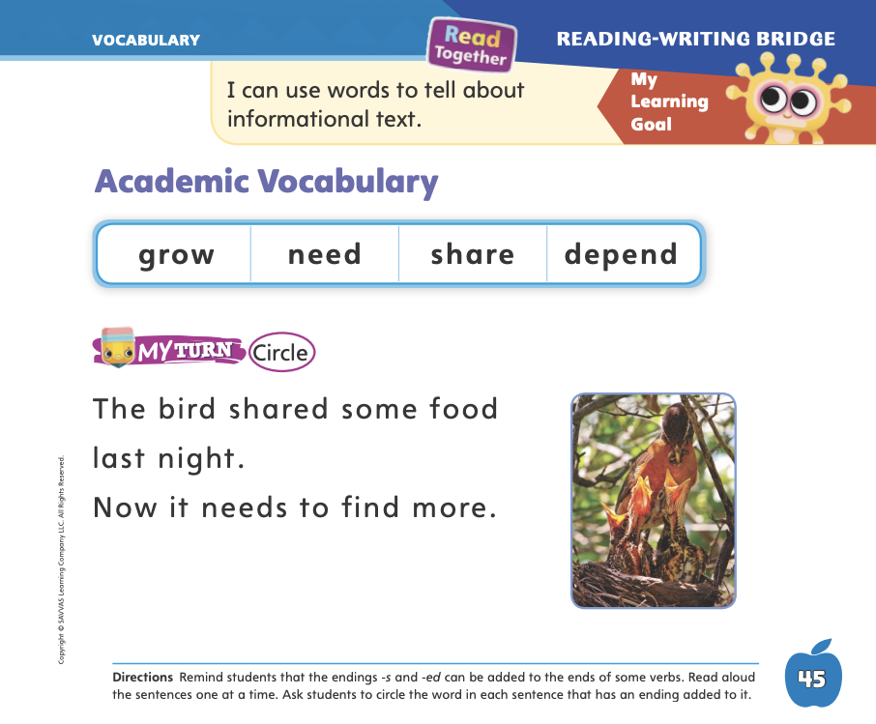
Page 45
Academic Vocabulary
Turn to page 45 in your Student Interactive and complete the activity.
Notes:
Remind students that word parts can be added to words to make related words. Related words are words that are connected in some way, such as having the same base word. Word parts can be added to the end of verbs, or action words, to make related words.
To show something that already happened, you can sometimes add -ed to the end of a verb.
To tell that one person or animal is doing something, you sometimes add -s to the end of a verb.
Write the word jump on the board. Have everyone stand up and jump. As you are jumping, say: We jump. Ask students what you just did. Add -ed to jump in a different color. We jumped. Ask one student to jump. Add an -s to the word jump in a different color. [Matt] jumps. Repeat this activity by writing words with and without word parts: play/plays/played. Ask students to identify the word part.
Read aloud the sentences on p. 45 in the Student Interactive. Have students circle the words with endings

Slide 16
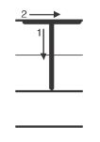
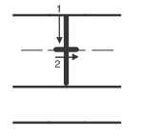
Handwriting
Notes:
Show students the alphabet. Point out the letters Tt. The letter t is made from two straight lines—one vertical line that goes down (trace it with your finger) and a horizontal line that goes across.
Draw an uppercase T on the board as you explain how to make it. To make a capital T, you draw a line down. Then you pick up your pencil and draw a line across the top. Have students practice making a capital T in the air. Continue by modeling how to write lowercase t.
Have students use Handwriting p. 76 in the Resource Download Center to practice writing Tt. Click path: Realize -> Table of Contents -> Resource Download Center -> Handwriting Practice -> U2W2L1 Handwriting Practice

Slide 17
Page 49
Writing – List Book
Turn to page 49 in your Student Interactive and complete the activity.
Notes:
A list book tells readers everything they need to know about a topic. It has a main idea and details. A list book also contains simple graphics.
Inform students that your class will be writing list books. List books tell readers all about something and list all the specific things someone should know about the topic.
Show a book from the stack and read the book’s title. Think aloud after reading the title: It looks like this book will tell me about __________. I’m going to read this list book to learn everything I need to know about this topic. Read the book aloud, pausing so students can look at the pictures. Then say: This book is a list book. It is a list book because it tells all about a topic. It has a main idea, and it lists details about the main idea.
Have students turn to p. 49 in the Student Interactive. Read the page aloud. Then return to the book you just read and point out the title, the main idea, and each detail. This book is a list book because it has a title, it has a main idea, and it lists details about the main idea.
Read a few more stack books. Point out the title, main idea, and details as you read each one.

Slide 18
Independent Writing
Read books to develop your understanding of list books.
Start writing your own list book.
Notes:
During independent writing time, students should read additional books from the stack to continue developing their understanding of list books.
Modeled Talk through how to find the main idea in a list book.
Shared With students’ input, make a list of details they can recall from a stack book.
Guided Prompt students to think of another detail that could be in a list book they have read.
If students show understanding, students should transition to writing their own list books. Make blank stapled booklets available to them for this purpose.
As students write, use the conference prompts in the Teacher’s Edition or Resource Download Center to provide support. Click path: Table of Contents -> Resource Download Center -> Writing Workshop Conference Notes
Call on a few students to share a book from the stack or a book they are writing and explain why it is a list book. Tell the class to think about similar topics that could be made into list books.

Slide 19
Language and Conventions
One | More Than One
Notes:
Remind students that a singular noun names just one person, animal, place, or thing. A plural noun names more than one person, animal, place, or thing. Plural nouns can be formed by adding -s or -es to a noun.
Write the categories One and More Than One on the board. Also draw stick figures to show One and More Than One. Have volunteers name examples of common nouns and help you write and say the singular and plural form of each word. If students say a word with an irregular plural, such as child/children, just say and write the singular and plural nouns in your chart. However, explain that some plurals are formed in different ways.
Pair students and have them take turns saying a singular noun and having their partner say the plural of that noun.

Slide 20
Lesson 2

Slide 21
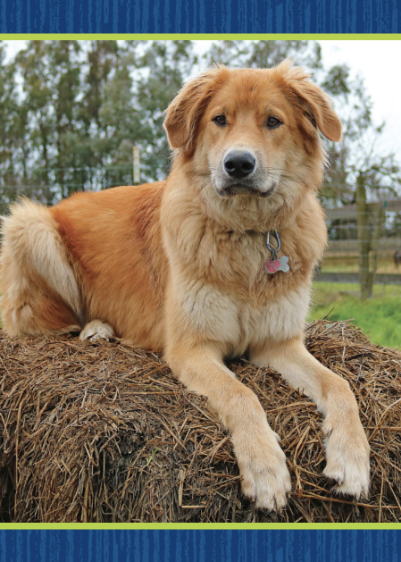
Phonics
Dd
Notes:
Show students the dog Picture Card and tell them that it is a picture of a dog. Listen as I say the sounds in this word: /d/ /o/ /g/. I hear the sound /d/ at the beginning of dog. Say the sound /d/ with me. Click path -> Table of Contents -> Unit 2 Week 1 Informational Text -> Lesson 1
Show students the spelling of the word on the back of the card. Point to the d and say /d/. Do you hear the sound /d/? What letter makes the sound /d/? Have students identify the letter d. Write the letters Dd on the board. Have students trace the letters Dd in the air as you lead them.
Point to the letters Dd on the board. Listen carefully to the following words: mad, dot. One word begins with /d/ and the other word ends with /d/. Listen again: /m/ /a/ /d/ /d/ /d/, /d/ /d/ /d/ /o/ /t/. Do you hear the word that begins with the sound /d/? Have a volunteer identify the word that begins with the sound /d/. Then have a student identify the word that ends with the sound /d/.

Slide 22
Page 18
Apply
Turn to page 18 in your Student Interactive and complete the activity.
Notes:
Have students complete p. 18 of the Student Interactive.

Slide 23
High-Frequency Words
are
that
of
Notes:
Tell students that high frequency words are words they will hear and see over and over in texts. Write and read the words are, that, and of.
Have students
repeat the words after you.
spell each word, clapping as they say each letter.

Slide 24
Page 30
Preview Vocabulary
Notes:
Introduce the words butterflies, geese, and whales on p. 30 in the Student Interactive. As you read each word, have students point to the picture to help them make real-life connections between words and their use.
Ask students to raise their hands if they have seen the animal or know anything about it.
Explain that these are words students will see in the text. Have them look for the words as you read.

Slide 25
Page 31
Print Awareness
Notes:
Turn to p. 30 of the Student Interactive. Use the sentence under "Read" to demonstrate basic concepts about sentences: they are made of words, tell an idea, begin with a capital letter, end with a punctuation mark. Have students identify the beginning and end of the sentence.
Next, point to the section “Meet the Author.” Ask: How many sentences are in this section? (3) How many words are in the first sentence? (10)

Slide 26
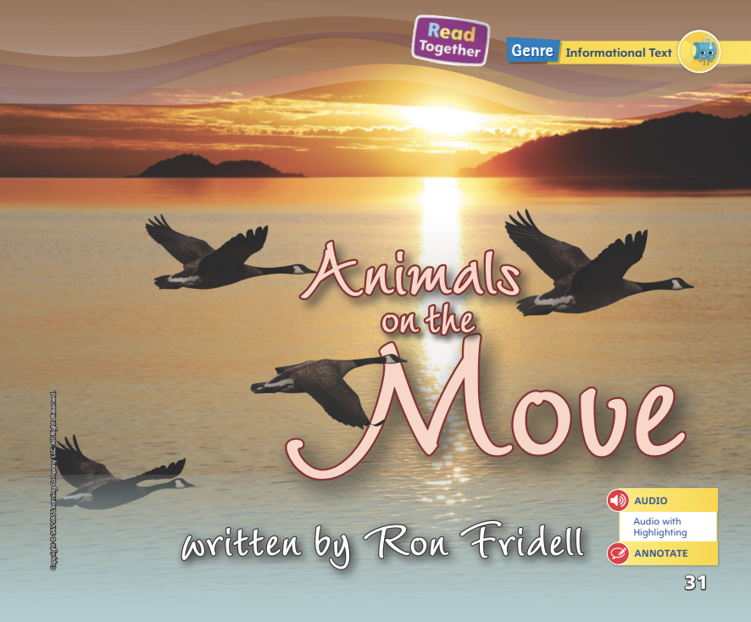
Page 31
First Read Strategies
Notes:
Explain that we often read for a purpose. I can tell that this is an informational text. I read an informational text to learn about a topic, such as why animals move from place to place. Have students set a purpose for reading Animals on the Move. After students complete the First Read ask, What did you learn?
READ Read or listen to the text. During the first reading, work to understand what the text is about.
LOOK Look at the pictures to help you understand the text.
ASK Ask questions about the text to deepen understanding.
TALK Talk to a partner about the text.
Students may read independently, in pairs, or as a class. Use the First Read notes to help them connect with the text and guide their understanding.

Slide 27
Page 32,33
First Read – Animals on the Move
Notes:
Look together at the text.
THINK ALOUD As I read, I learn that animals take long trips for different reasons. I will read more to learn about which animals travel and why.

Slide 28
Page 34,35
First Read – Animals on the Move
Notes:
Read Together.

Slide 29
Page 36,37
First Read – From Nectar to Honey
Notes:
Read together.
THINK ALOUD I see on p. 36 that the geese are in the grass eating. This tells me something about why the geese migrate. They migrate to find food in the winter.

Slide 30
Page 38,39
First Read – From Nectar to Honey
Notes:
Read Together.

Slide 31
Respond and Analyze
Talk What did you like most about Animals on the Move?
Illustrate Details If you could be one of these animals, which would you be? Draw a picture of that animal and explain why.
Notes:
Use these suggestions to prompt students’ initial responses to Animals on the Move.
Talk What did you like most about Animals on the Move?
Illustrate Details If you could be one of these animals, which would you be? Draw a picture of that animal and explain why.

Slide 32
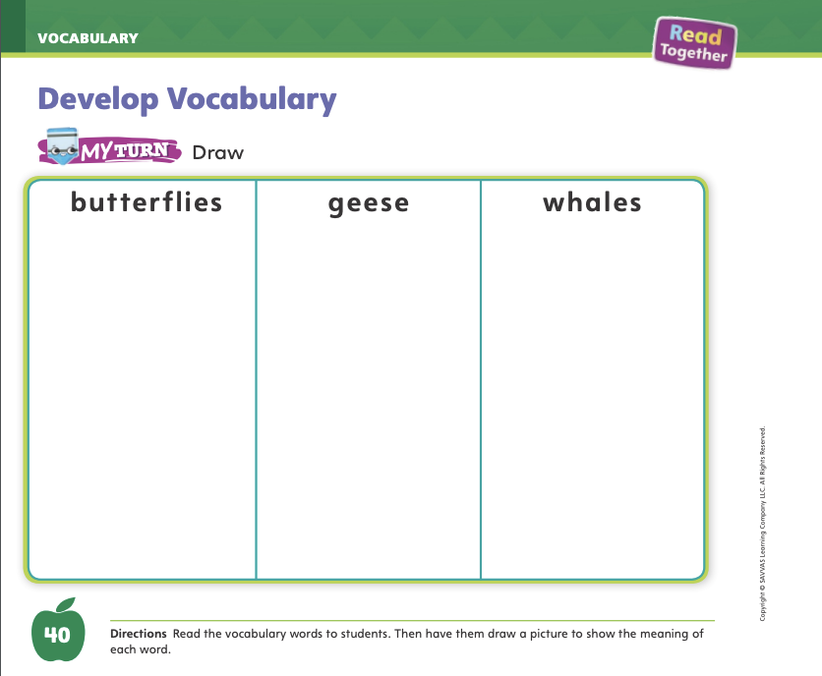
Page 40
Develop Vocabulary
Turn to page 40 in your Student Interactive and complete the activity.
Notes:
Tell students that the words butterflies, geese, and whales all name animals.
Look at the pictures.
Think about the word that names each animal.
Ask yourself how you would describe this animal. What does the animal look like? What does it do?
Have students turn to p. 40 in the Student Interactive. Read each of the vocabulary words to students. When I look at the picture of butterflies, I see that they have wings, are colorful, and fly. Then have them draw a picture to show each word. Remind them that the words are plural, so their pictures should have more than one butterfly, goose, or whale.
Have students use the strategies for developing vocabulary.
Have students practice developing vocabulary by completing p. 40 in the Student Interactive.

Slide 33
Page 41
Check for Understanding
One fact I learned is…
Why does the author include pictures?
Why do animals need to go to warm places?
Notes:
Have students complete the Check for Understanding on p. 41 in the Student Interactive.

Slide 34
Writing – List Book
What is the book mostly about?
What are some details your remember from the book?
Notes:
The main idea of a text tells you what the book is mostly about. The details in a text support the main idea. Details of a text can be words or pictures that stay on topic and give you information about the main idea.
Choose a stack text. Think aloud as you look at the front cover, back cover, title page, and interior pictures. Read the title and talk about the graphics. Ask students what they think the main idea of the book could be. Make a list of their suggestions.
Read the stack text aloud. When you are finished reading, ask students: What is this book mostly about? Make a list of their answers. Then ask students: What are some details you remember from the book? Write their answers. Refer back to the book and read some details aloud to remind students.
Next, think aloud to identify the main idea. The words in the book gave us details about ________. The pictures supported the details by showing ________. I think the main idea is ________. Write the main idea on the board.
Have students choose a stack book or a book from the classroom library. Tell them to look through the pictures and front and back covers. Can they identify the main idea?

Slide 35
Independent Writing
Read books to see how authors write main ideas and details.
Write your own list book.
Notes:
During independent writing time, students can read additional books from the stack to see how authors write main ideas and details.
Modeled Choose another stack text and do a Think Aloud.
Shared Have students share the main idea of a book they have read.
Guided Use a stack text to provide explicit instruction about writing a list book.
If students show understanding, they can transition to writing their own list books.
As students write, use the conference prompts in the Teacher’s Edition or Resource Download Center to provide support. Click path: Table of Contents -> Resource Download Center -> Writing Workshop Conference Notes
Call on a few students to read the details from their list book or from a stack book. Have students figure out the main idea of the book based on what was shared.

Slide 36
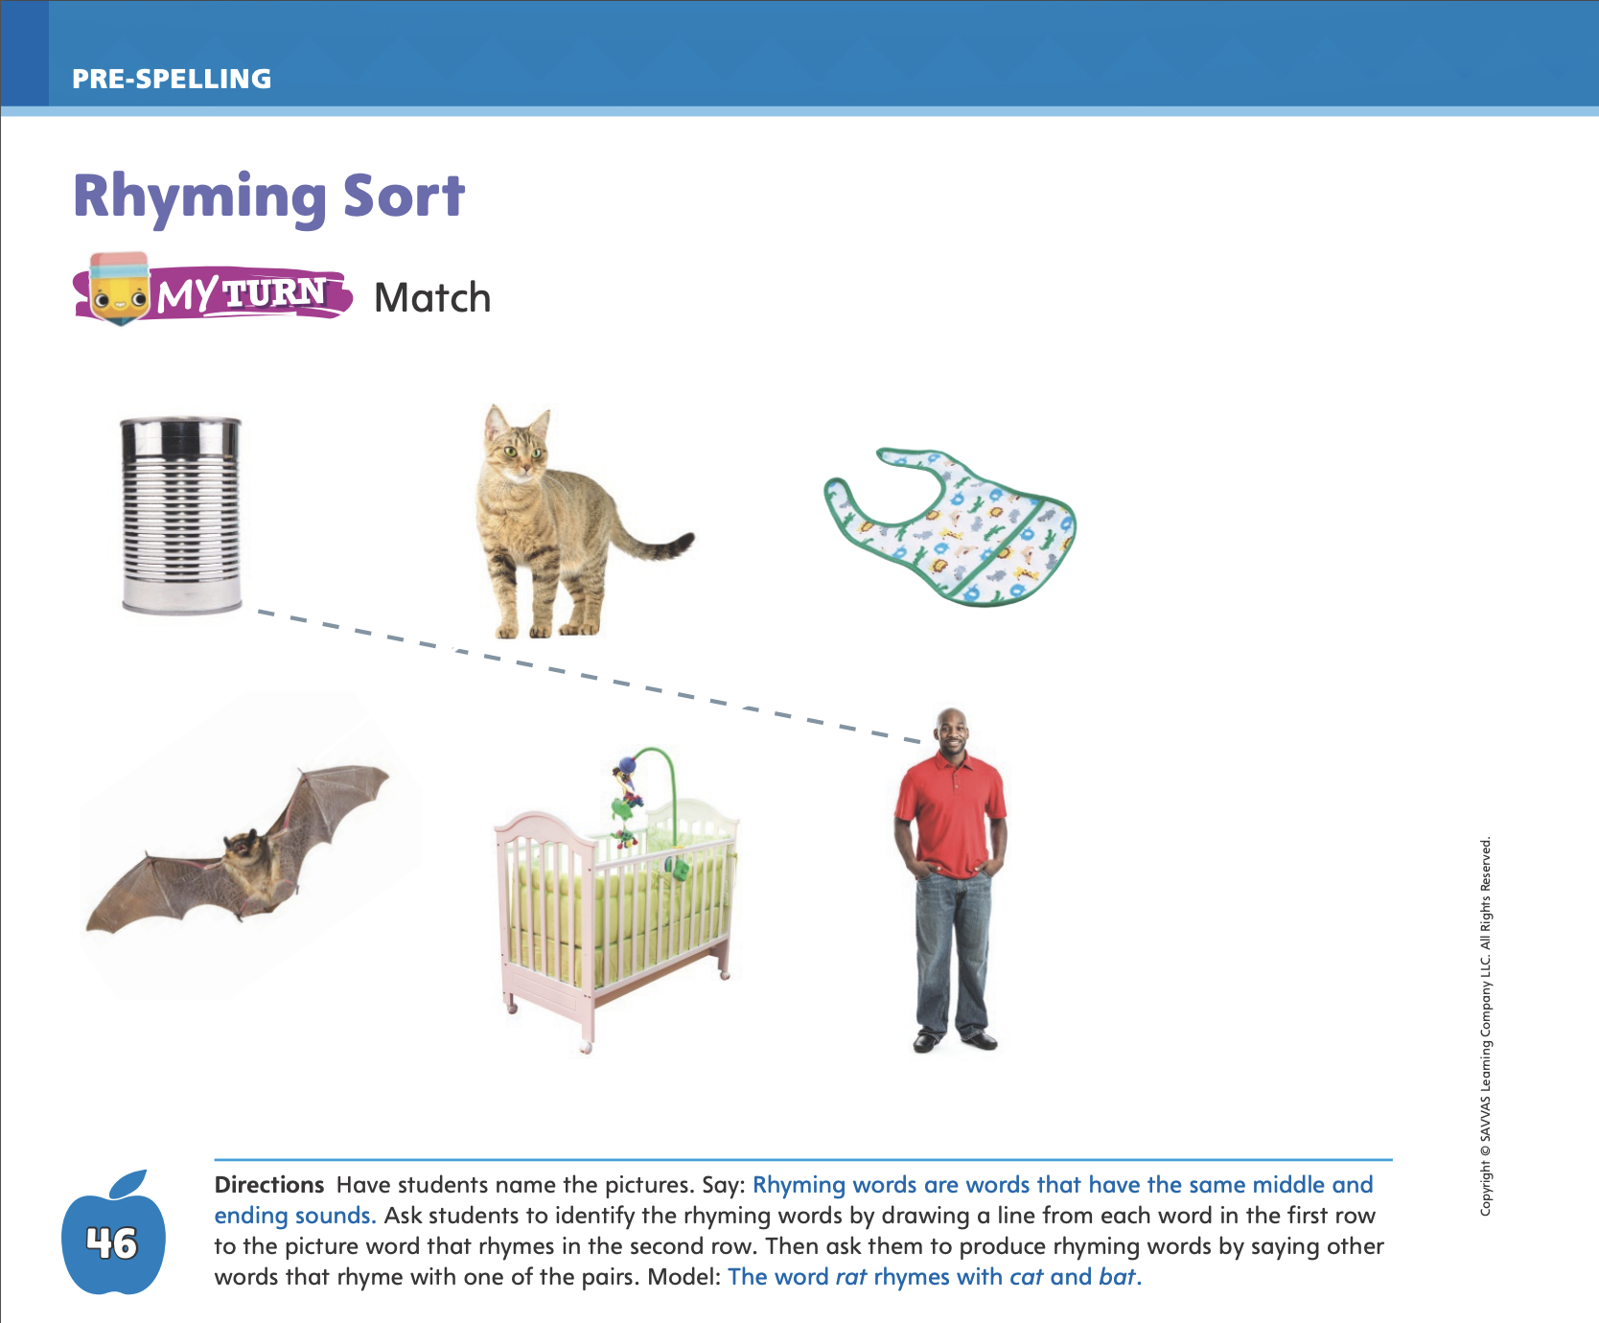
Page 46
Rhyming Sort
Turn to page 46 in your Student Interactive.
Notes:
Remind students that rhyming words end with the same sounds but have different beginning sounds.
Say: Listen to these words: run, fun. Both words end in the sounds /u/ /n/, but their beginning sounds are different. Run and fun rhyme. Then have students produce these rhyming words by repeating them after you.
Have students turn to p. 46 in the Student Interactive and ask them to point to the picture of a can. Then have them identify rhyming words by drawing a line from the can to the picture that rhymes with can.
Have students complete the activity on p. 46. Have them identify each rhyming pair by drawing a line from the picture in the top row to the rhyming picture in the bottom row. Then have students produce rhyming words by choosing a rhyming pair and saying other words that rhyme with the pair.

Slide 37
Language and Conventions
Words used to describe nouns are adjectives.
Think of adjectives to describe objects in the classroom.
Notes:
Tell students that authors use words to describe nouns. These are called adjectives.
Hold up a book: This book is small. Small is an adjective because it describes the book. It tells what the book looks like. Hold up a pencil. This is a yellow pencil. Yellow describes the pencil. It tells what the pencil looks like.
Hold up or point to other objects in the classroom. Have students think of adjectives they could use to describe each object.

Slide 38
Lesson 3

Slide 39
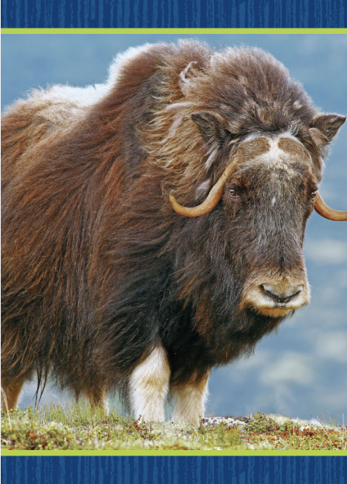
Page 19
Phonological Awareness
Turn to page 19 in your Student Interactive and complete the activity.
Notes:
Today we are going to learn a new sound. Listen carefully: /k/ /k/ /k/. The sound /k/ is made by placing the back of your tongue toward the back of your mouth. Then push air through your mouth and release it, making the sound /k/. Show students how to make the sound /k/ and have them practice it.
Display the Picture Card yak. This is a picture of a yak. Listen to the ending sound as I say this word: ya- /k/. What sound does yak end with? Students should supply the sound /k/. Then say the following words and have students give a thumbs-up if they hear the sound /k/ at the end of the word. Have them give a thumbs-down if they hear the sound /k/ at the beginning of the word: book, kit, king, speak, keep, key, dock, mark, hook. Click path -> Table of Contents -> Unit 2 Week 2 Informational Text -> Lesson 3
Point to the picture of the fork on p. 57 of the Student Interactive. Fork has the sound /f/ at the beginning. Have students circle the pictures of all the words that begin with the same initial sound as fork.

Slide 40
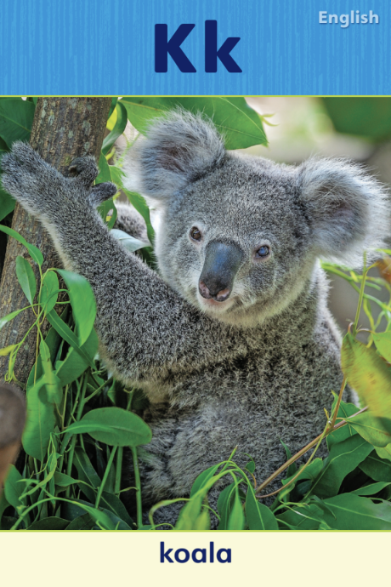
Page 20
Phonics
Turn to page 20 in your Student Interactive and complete the activity.
Notes:
Tell students that the sound /k/ can be spelled with the letter k. Display the Kk Alphabet Card. Point to the koala on the card and tell students the word koala begins with k. Point to the letters on the card, and tell students the names of these letters are uppercase K and lowercase k. Write uppercase and lowercase Kk on the board and slowly trace the letters as you say the sound /k/.
Have students turn to p. 20 in the Student Interactive. Let’s say the picture word king and listen to the beginning sound: /k/ -ing. The word begins with /k/. Can you identify, or tell me, what letter spells the sound /k/? Point to the letters Kk. Students should trace the uppercase and lowercase letters on the page. Have them point to the letter k and tell you what sound it represents.
Have students complete the activity on p. 20 in the Student Interactive.

Slide 41
Page 21
High-Frequency Words
Turn to page 21 in your Student Interactive and complete the activity.
Notes:
Say: Today we will practice reading the high-frequency words of, are, and that. Have students read the words at the top of p. 21 in the Student Interactive with you: of, are, that.
Have students look at the words at the top of p. 21. Say: I will read a word, and I want you to point to it. Then we will read the word together. Read of, and have students point to it. Now let’s read the word together: of. Repeat with the other words.
Have students read the sentences on p. 21 with you. Ask them to identify the words of, are, and that in the sentences and underline the words. Then have them read the sentences with a partner.

Slide 42
Page 31
Main Idea and Supporting Evidence
Notes:
Remind students that an informational text has a main idea. Identifying the main idea will help a reader better understand the text.
The main idea is what the text is mostly about. When we read, we try to connect the important details to the main idea.
Authors make sure that the facts and details they use tell something important about the main idea.
Tell students that you will help them find the main idea in Animals on the Move. I know that the title of the book, the pictures, and the text will all help me figure out the main idea. The title is Animals on the Move. I can see on the first few pages that all these animals are moving, so I think moving will have something to do with the main idea.
Now, I will go back and reread the text. Read aloud p. 32. What does the author want me to know? From these sentences, I can see that the author wants me to know that animals travel, or migrate, for different reasons. This is the main idea. The pictures and other parts of the text provide details, or examples, of some of these animals. They provide evidence to support the main idea.
Read the Close Read note on p. 33 in the Student Interactive with students and guide them to underline the main idea.
Have students flip through the pictures to identify supporting details, namely the animals that migrate and why they migrate. Help students make the link between these examples and the main idea.

Slide 43
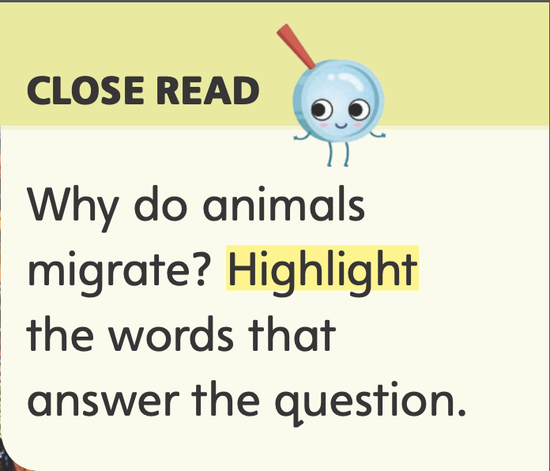
Page 32,33
Close Read – Identify Main Idea
Turn to page 32 and 33 in your Student Interactive.
Notes:
Read aloud the Close Read note on p. 35 of the Student Interactive: Why do animals migrate? Then read aloud pp. 32–33 one at a time and have students highlight the word on each page that names the main idea. DOK 2

Slide 44
Page 42
Main Idea and Supporting Evidence
Turn to page 42 in your Student Interactive and complete the activity.
Notes:
Have students use the strategies for finding the main idea.
Have students complete the My Turn activity on p. 42 in the Student Interactive by writing a word that tells the main idea and circling the picture that shows evidence that supports the main idea.

Slide 45
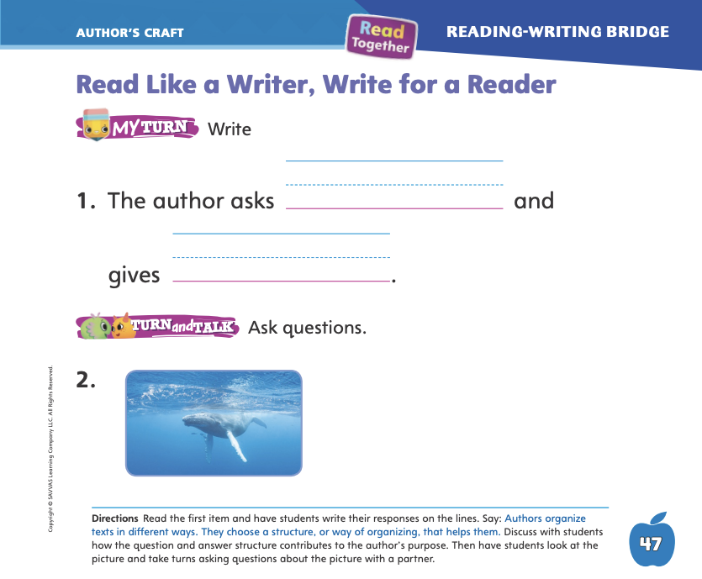
Page 47
Read Like a Writer, Write for a Reader
Turn to page 47 in your Student Interactive and complete the activity.
Notes:
Explain to students that authors organize books in different ways. The organization is how the book tells information. If you are writing about someone’s life, you might start with his or her birth and write about events in order. Or you could write about the most interesting things first.
One type of organization is to ask and answer questions. Questions help readers follow the text. Readers might think about the questions before the author answers them.
Have students look at pp. 36–37 in the Student Interactive. I see that this text is organized with questions and answers. Page 36 has the question Why do geese migrate? Then the next sentence answers that question. Geese fly to warm places to find food.

Slide 46
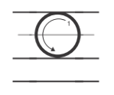
Handwriting
Notes:
Show students the alphabet. Challenge them to find the letters Oo. Point out that the letter o has no straight lines. Point out that uppercase letter O is larger than the lowercase o.
Model how to write the uppercase letter O. Show students where to begin the letter and how to form it. Have students practice writing the letter in the air with their fingers. Then repeat with the lowercase letter o.
Have students use Handwriting p. 77 in the Resource Download Center to practice writing the letters Oo. Click path: Table of Contents > Resource Download Center > Handwriting Practice > U2W2L3 Handwriting Practice

Slide 47
Writing – List Book
Authors use pictures or graphics to explain the main idea.
What items might you take on picnic?
Notes:
Authors write books about what they know or what they want their readers to learn about. They decide on which pictures, or graphics, to use to best explain the details of their topics. Before they start writing, authors:
Choose the main idea of their book
Decide which details will support the main idea best
Figure out which pictures or illustrations help tell more about their topic
Choose a stack book to demonstrate a strong incorporation of graphics. Read aloud through the book without showing the pictures. Ask students to picture in their minds what you are reading about. Then reread the title and show students the cover. Have them describe what they see. Is it different from what they pictured the first time? Reread the book, pausing after each page to let students observe the pictures. Ask students to tell you what they see in each picture. Without pictures, we wouldn’t know what the main idea and details look like. Pictures are very important. When you write your book, you can draw pictures too.
Then inform students that you want to write a list book about what you might take to a picnic. Have students come up with a strong title. Next, talk through and write down what items might be taken on a picnic. (picnic basket, blanket, food, drinks, plates, utensils, napkins) Draw simple pictures to go with each item. Explain to students that each picture can be a page in your list book.

Slide 48
Independent Writing
Read books to see how authors incorporate graphics.
Write and illustrate your own list book.
Notes:
During independent writing time, students can read additional books from the stack to see how authors incorporate graphics.
Modeled Use a stack book to help students understand how graphics add details to a text.
Shared Guide students to think of details to draw in their list books.
Guided Encourage students to add more details to their graphics.
If students show understanding, they can transition to writing and illustrating their own list books.
As students write, use the conference prompts in the Teacher’s Edition or Resource Download Center to provide support. Click path: Table of Contents -> Resource Download Center -> Writing Workshop Conference Notes
Call on a few students to share a picture from the list book they are writing or one from the stack. Other students may ask questions or make suggestions about the picture.

Slide 49
Language and Conventions
The small dog runs.
This is a red pen.
Notes:
Write the following sentence on the board: The small dog runs. Read aloud the sentence. Then have students read with you as you point to each word. Ask them to say the adjective. Tell them that an adjective tells about a noun—a person, animal, place, or thing. Point out that this adjective tells about the dog’s size.
Next, turn your attention to articles. Tell students that articles are a, an, and the. Point to the article. Tell them that the article the refers to a specific dog. Tell students that articles are also known as determiners.
Model another example. Hold up a pen and write a sentence about it on the board:
Red is an adjective that tells about the color of the pen. The word a is an article that tells you that this is just one of many red pens. Point to other things in the room and have students supply an adjective and an article for the object.

Slide 50
Lesson 4

Slide 51
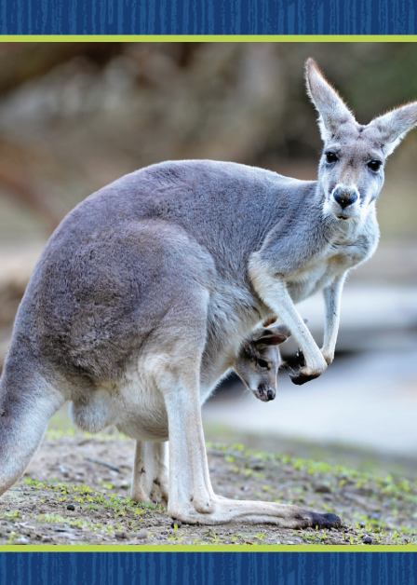
Page 22
Phonics
Turn to page 22 in your Student Interactive and complete the activity.
Notes:
Display the Picture Card kangaroo. This is a picture of a kangaroo. I hear the sound /k/ at the beginning of kangaroo. Say the sound /k/ with me. What letter spells the sound /k/ in kangaroo? Have students identify the letter k. Write the letters Kk on the board. Have students write the letters Kk in the air as you lead them.
Point to the letters Kk on the board. Listen carefully to the following words: kit, speak. Both words have the sound /k/ in them. Listen again: /k/ /i/ /t/, /s / /p/ /ē/ /k/. Do you hear the sound /k/ in each word?
Have students complete p. 22 in the Student Interactive.

Slide 52
Page 23
Decodable Story
are
that
of
Turn to page 23 in your Student Interactive. Read “The Kid”.
Notes:
Have students turn to p. 23 of the Student Interactive. We are going to read a story today about a kid and some animals. Point to the title of the story. The title of the story is The Kid. I hear the sounds /k/ and /d/ in the word kid. In this story, we will read other words that have the sounds /d/ and /k/.
Remind students of this week’s high-frequency words: are, that, of. Tell them they will practice reading these words in the story. Display the words. Have students read them with you. When you see these words in the story The Kid, you will know how to identify and read them. You will also see other high-frequency words you have learned: the, we, I, a, to.

Slide 53
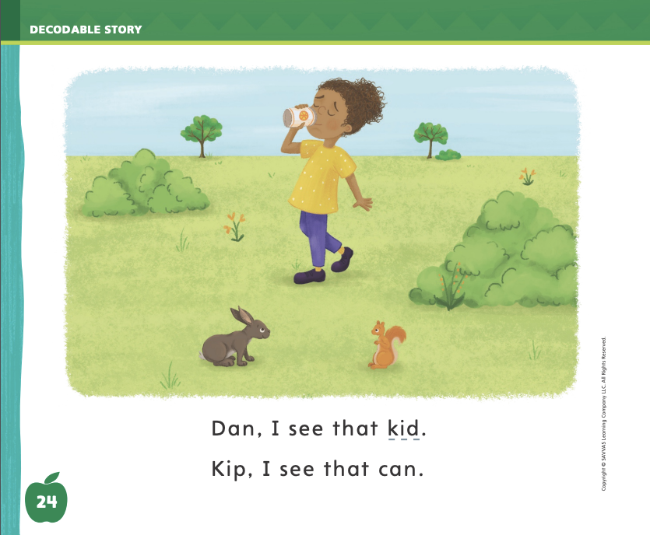
Page
24,25
Decodable Story
Notes:
Have students whisper read the story as you listen in. Next, have students reread the story page by page with a partner. Listen carefully as they use letter-sound relationships to decode. Partners should reread the story. This time the other student begins.
After students have read the story, call their attention to the title. I see the letter K in this word. What sound does the letter K spell? Help them identify, or say, the sound /k/. Repeat with the sound /d/ at the end of the word Kid. Have students highlight the word with the sound /d/ in the title.
Call students’ attention to the sentence on p. 23. Which word includes the sound /d/? Point to it. Help students identify, or say, the sound /d/. Then have them find and highlight the word with the sound /d/ in the sentence.
Have students turn to pp. 24–25. Which words include the sound /k/? Point to them. Help students identify, or say, the sound /k/. Then have them find and underline the words with the sound /k/. Have them tell you the high-frequency words they see.

Slide 54
Page 31
Make Inferences
Notes:
Explain that authors do not always directly say everything a reader needs to know. They expect readers to make inferences. When readers make inferences, they look at what the author tells them in words and pictures. Then they use their knowledge and evidence to think about what these words and pictures mean.
Guide students to make an inference. Act like you are shivering. Then ask students what they can tell from your actions. You can tell I am cold even though I did not tell you I was cold. You used what you already knew plus evidence you saw to make an inference, or a guess, that I am cold. You can do this when you read. Have students turn to p. 35 in the Student Interactive. The text says, or gives evidence, that monarch butterflies fly south to stay alive. I know that it is warmer in the south. I can make the inference that they fly south for the winter months because it is warmer there.
Read the Close Read notes on pp. 35, 37, and 39 in the Student Interactive with students and have them highlight words in the text that answer the question. Then have them use these details to make inferences about animal migration. Provide assistance as needed.

Slide 55
Page 34,35
Close Read – Make Inferences
Turn to page 34 and 35 in your Student Interactive.
Notes:
Tell students that these pages tell reasons that animals migrate. Work with them to find and highlight the two reasons on pp. 34–35. Then guide students to use the details to make an inference about the places where the animals live before they migrate. DOK 2

Slide 56
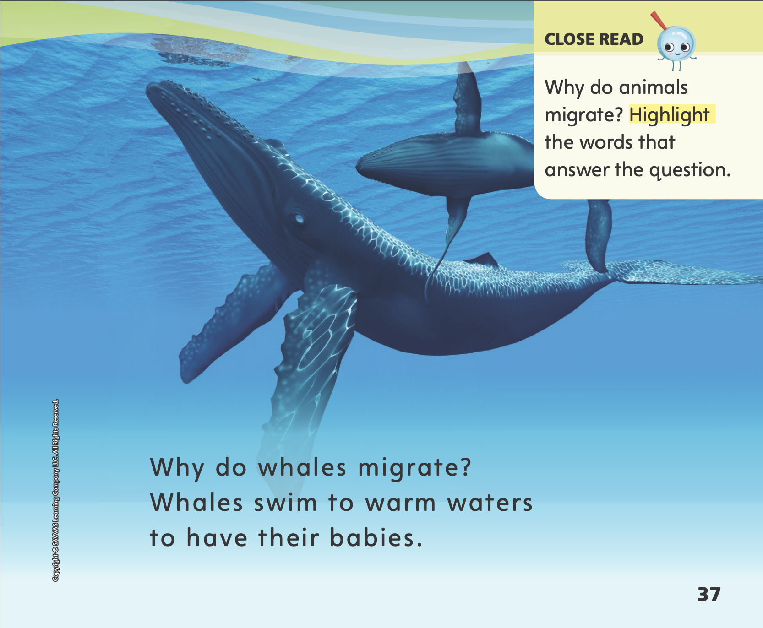
Page 37
Close Read – Make Inferences
Turn to page 37 in your Student Interactive.
Notes:
Read aloud the Close Read note on p. 37 of the Student Interactive. Have students find the two phrases that answer the question. Guide them to make an inference about the places where the animals lived. DOK 2

Slide 57
Page 38,39
Close Read – Make Inferences
Turn to page 38 and 39 in your Student Interactive.
Notes:
Read aloud the Close Read note on p. 39. Have students find the answer on p. 38. Guide them to make an inference about the north in the spring. DOK 2

Slide 58
Page 43
Make Inferences
Turn to page 43 in your Student Interactive and complete the activity.
Notes:
Explain that authors do not always directly say everything a reader needs to know. They expect readers to make inferences. When readers make inferences, they look at what the author tells them in words and pictures. Then they use their knowledge and evidence to think about what these words and pictures mean.
Guide students to make an inference. Act like you are shivering. Then ask students what they can tell from your actions. You can tell I am cold even though I did not tell you I was cold. You used what you already knew plus evidence you saw to make an inference, or a guess, that I am cold. You can do this when you read. Have students turn to p. 35 in the Student Interactive. The text says, or gives evidence, that monarch butterflies fly south to stay alive. I know that it is warmer in the south. I can make the inference that they fly south for the winter months because it is warmer there.
Read the Close Read notes on pp. 35, 37, and 39 in the Student Interactive with students and have them highlight words in the text that answer the question. Then have them use these details to make inferences about animal migration. Provide assistance as needed.
Have students use the strategies for making inferences.
Read aloud the directions on p. 43 in the Student Interactive. Then have students draw a picture to show why animals go north again in the spring.

Slide 59
Page 50
Writing – List Book
Turn to page 50 in your Student Interactive and complete the activity.
Notes:
A topic is what a book is all about. To think of a topic for their book, authors can brainstorm. Brainstorming helps you think of ideas. One way to brainstorm is to draw a mind map.
Tell students you would like to write a list book to teach readers about something, but you can’t think of just one good idea. So you will brainstorm ideas about things you know a lot about.
On a flipchart, draw a big circle and write “What I Know About” in the middle. Then think aloud to list things you know a lot about. I know a lot about my family. I could write a list book to name each person in my family. I also know a lot about soccer. I could list all of the equipment I wear in a soccer game. Something else I know a lot about is my house. I could list all the rooms in my house, or I could list what is in my bedroom. Each of these ideas is a topic I could write about. When you are finished mind mapping, talk through which topic you will choose to write about and why. (you know the most about it, you can write the clearest details about it, you can draw a picture of it, etc.)
Have students turn to p. 50 in the Student Interactive. Read the page together. Then draw and discuss a mind map as a class to practice generating ideas for students’ list books.

Slide 60
Independent Writing
Think of the things you know about your topic. Write and draw your list book.
Notes:
After this lesson, students should transition into independent writing and conferences.
Encourage students to think of all the things they know about their topic and then begin or continue writing and drawing in their list book.
Modeled Use stack texts to mind map other ideas for list books.
Shared Prompt students to generate ideas by looking through the stack texts or the classroom library.
Guided As students work, encourage them to think about what they know a lot about or what they like to do. This will help them decide on the details for their list books.
As students write, use the conference prompts in the Teacher’s Edition or Resource Download Center to provide support. Click path: Table of Contents -> Resource Download Center -> Writing Workshop Conference Notes
Call on a few students to hold up and share their mind map with the class. Ask students to share which topic they chose and why, and how they felt about brainstorming.

Slide 61
Page 48
Language and Conventions
Turn to page 48 in your Student Interactive and complete the activity.
Notes:
Have students edit for an article and adjective on p. 48 of the Student Interactive.

Slide 62
Lesson 5

Slide 63
Phonological Awareness
Notes:
Display the Picture Card dog. Point to the picture of the dog. Listen to the sounds as I say this word slowly: /d/ /o/ /g/. What is the first sound? Say it with me: /d/. What is the next sound? Say it with me: /o/. What is the last sound? Say it with me: /g/. This word has three sounds: /d/ /o/ /g/. Now listen as I blend the sounds, or say them together quickly, to say the word: dog. Repeat with the word kit.
Say words one at a time and have students segment and identify the phonemes in each word. Then have them blend the phonemes to say the whole word. Use these words: dot, dig, dip, kit, kid, kin.

Slide 64
Phonics
Kim
sad
Dd
Kk
dab
kid
kit
dip
Kip
Notes:
Write the letters Dd and Kk on the board. Have students identify the letters as you point to them. Then review the sound for each letter: d/d/, k/k/. Ask students to say the sound as you point to each letter.
Tape a Dd or a Kk card on each student. Then write the word Dan on the board. We will read this word together. If you hear the sound /d/, stand up if you have the letters Dd taped to you. Stand up if you have the letters Kk taped to you if you hear the sound /k/. Point to each letter as you read the word aloud. Let’s read this word together: /d/ /a/ /n/, Dan. Continue the activity with the words Kim, dab, kit, Kip, sad, kid, and dip.

Slide 65
Page 26
Phonics
Turn to page 26 in your Student Interactive.
Notes:
Have students turn to p. 26 in the Student Interactive and read the words with a partner.

Slide 66
Page 27
Apply
Turn to page 27 in your Student Interactive and complete the activity.
Notes:
Have students look at p. 27 in the Student Interactive. Have them read the words in the word bank. Then have them read the sentences. Ask students to complete each sentence by writing the best word from the word bank on the lines.

Slide 67
High-Frequency Words
are
that
of
Notes:
Remind students that high frequency words are words that appear over and over in texts. Remind them they will learn many high-frequency words this year, which will help them become better readers. Say the word are and ask students what letters spell the word.
Have students
say the letters for the word as you write the letters on the board.
say and spell the word, tapping their arm for each letter.
repeat with of and that

Slide 68
Page 44
Reflect and Share
Turn to page 44 in your Student Interactive.
Notes:
Explain to students that retelling a text means putting it in your own words. When you retell a text, you tell the main idea and most important details. Tell students they can retell two texts, and then compare them according to how the main ideas and details are similar.
Think about the main idea of each text.
Tell about some of the important details. Details can include facts or examples.
Consider how the main ideas and details are similar across texts.
Use your own words to retell each text.
Model retelling and comparing texts. Listen as I retell the main idea and some important details from Animals on the Move: Animals migrate for different reasons. Some animals migrate to get away from the cold. They go somewhere warm in the fall. Now I can compare what I learned in Animals on the Move to another text I have read: “Time to Move!” Both texts tell about why animals migrate. Both texts tell me that animals migrate south when it starts to get cold.
Have students use the strategies for retelling and comparing across texts as they retell other texts they have read.
Have students turn to p. 44 in the Student Interactive. Ask them to take turns retelling the main idea and important details from Animals on the Move. Then ask them to tell their partner about another book they read about animals. Have partners talk about how Animals on the Move compares to these other texts.

Slide 69
Page 44
Apply
Why do some animals move from place to place?
Notes:
Have students use evidence from the texts they have read this week to respond to the Weekly Question. Tell them to discuss in small groups or write or draw their responses on a separate sheet of paper.

Slide 70
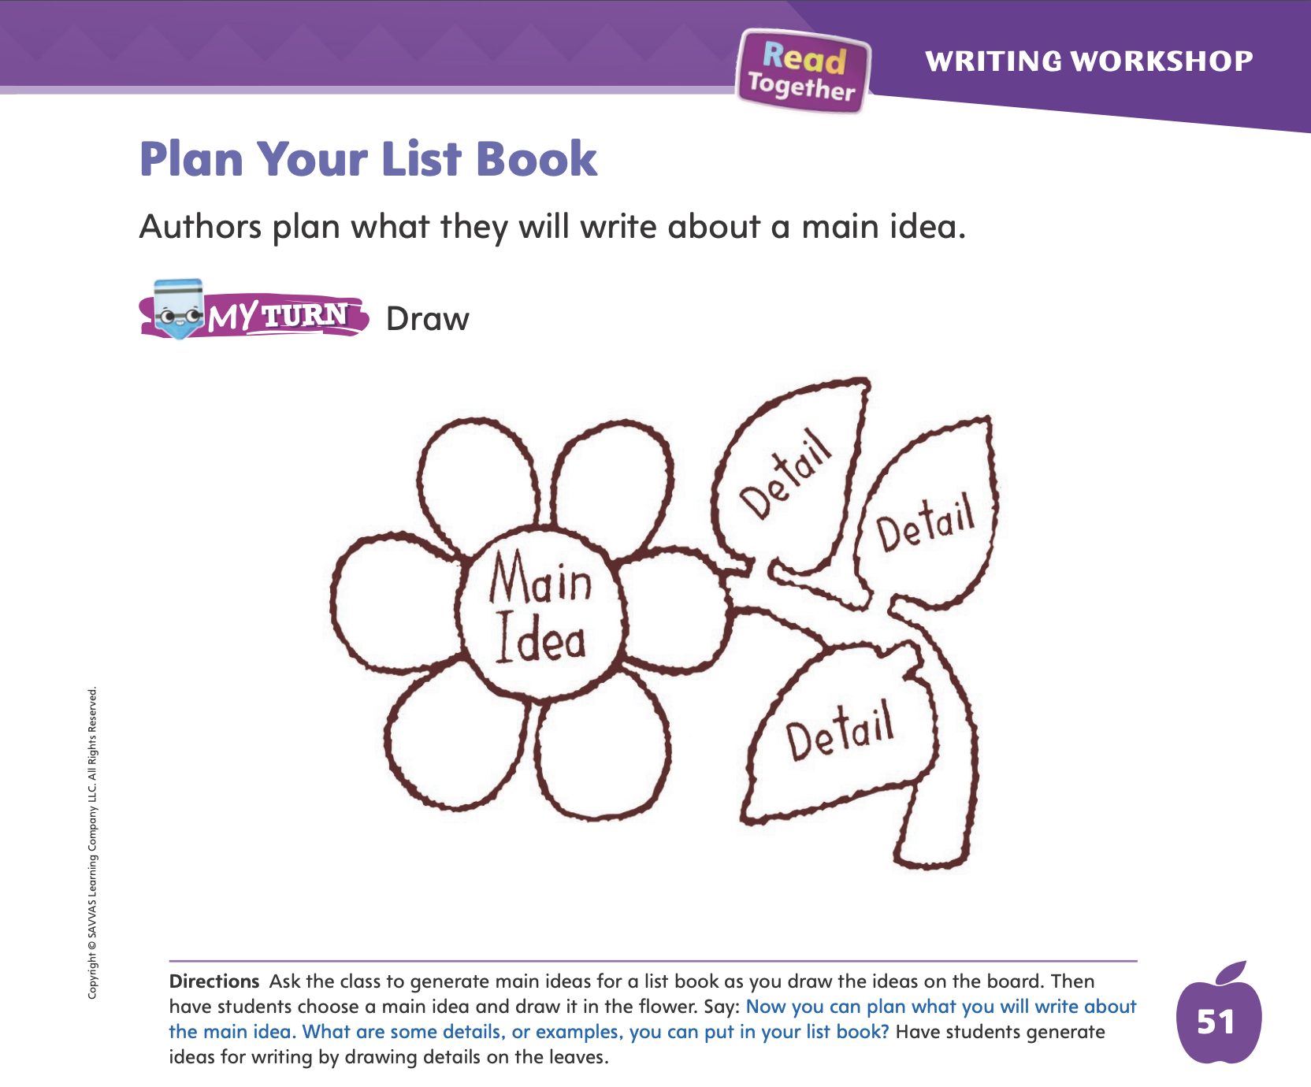
Page 51
Writing – List Book
Turn to page 51 in your Student Interactive and complete the activity.
Notes:
Graphic organizers can help writers plan their books before they write them. A graphic organizer for a list book can include the title, the main idea, each detail, and a simple picture illustrating each detail.
Draw a simple graphic organizer on a flipchart or board. The graphic organizer should include room for a title, a main idea, each detail, and simple pictures for each detail. Explain each part of the graphic organizer and how each part helps the writer make sure everything is included in the book that should be. Select a stack book. Explain to students that you will read the book aloud and use the book to fill out the graphic organizer.
Read aloud the title of the book and fill it in on the graphic organizer. Read each page of the book and fill in each detail. Add simple pictures. Then ask students what the main idea of the book is and write that into the graphic organizer. Tell students that the author might have used a graphic organizer like this one to plan the book they just read.
Have students practice by drawing their own main ideas and details into the graphic organizer on p. 51 of the Student Interactive.
Call on a few students to discuss their list book’s main idea and details. As students share, other students should ask questions or make suggestions about other items that could be included within the speaker’s list book.

Slide 71
Language and Conventions
I see a black cat.
Which word in the sentence is an adjective?
A. see
B. black
C. cat
Notes:
Display the following sentence. Read aloud the sentence and then each question and answer choice.
I see a black cat.
Which word in the sentence is an adjective?
see
black
cat
(2) Which word is an article?
I
see
a
Have students complete Language and Conventions, p. 86, from the Resource Download Center. Click path: Table of Contents -> Resource Download Center -> Language and Conventions -> U2 W2

Slide 72
Language and Conventions
I see a black cat.
Which word is an article?
A. I
B. see
C. a
Notes:
Display the following sentence. Read aloud the sentence and then each question and answer choice.
I see a black cat.
Which word in the sentence is an adjective?
see
black
cat
(2) Which word is an article?
I
see
a
Have students complete Language and Conventions, p. 86, from the Resource Download Center. Click path: Table of Contents -> Resource Download Center -> Language and Conventions -> U2 W2

Slide 73
Unit 2: Week 1
Grade K

